Slide 1

Title and Photo

Slide 2
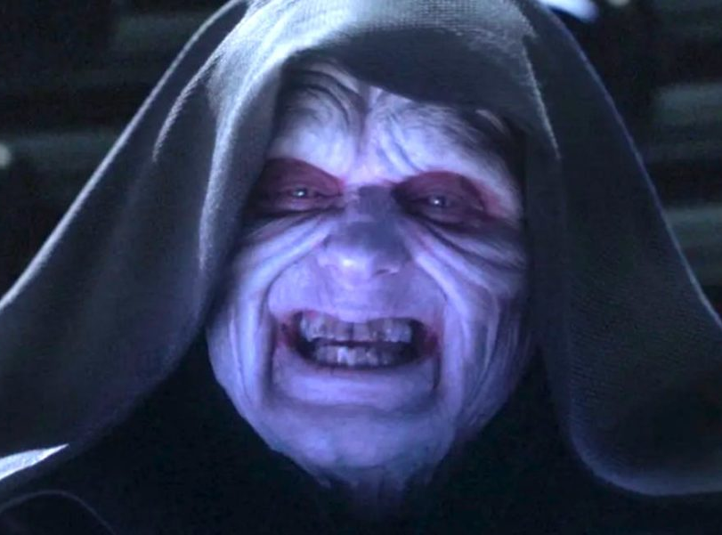

Slide 3
NAME | ADDRESS | RACE | PHONE | POPULARITY
Jar Jar Binks | 124 Under Ocean Lane, Naboo | Gungan | (333) 444-4444 | 1
Mr. Jar Jar Binks | 124 Under Ocean Lane, Naboo | Gungan | 3334444444 | 1

Slide 4
NAME | ADDRESS | RACE | PHONE | POPULARITY
Mr. Chewbacca | 432 Millennium Falcon St, Space | Wookiee | (333) 222-2222 | 9
Chewie | 432 Milenium Falcon Street, Space | NULL | 3332222222 | 9

Slide 5
NAME | ADDRESS | RACE | PHONE | POPULARITY
Obi-Wan Kenobi | 725 Tusken Raider Ln, Tatooine | Human | (333) 111-1111 | 10
Mr. OB1 | 752 Tuskin Raider Lane | Jedi | (555) 666-6666 | NULL

Slide 6


Slide 7
Gartner research shows…
“It takes $1 to verify a record as it’s entered, $10 to cleanse and de-dupe it, and $100 if nothing is done, as the ramifications of the mistakes are felt over and over again.”
Measuring the Business Value of Data Quality, Gartner, Published 10 Oct 2011

Slide 8


Slide 9



Slide 10
Prep Data
Blocking
Set Similarity Metrics
Create Ground Truth
Train & Evaluate Model

Slide 11
NAME | ADDRESS | RACE | PHONE | POP
Jar Jar Binks | 124 Under Ocean Lane, Naboo | Gungan | (333) 444-4444 | 1
Mr. Jar Jar Binks | 124 Under Ocean Lane, Naboo | Gungan | 3334444444 | 1
Mr. Chewbacca | 432 Millennium Falcon St, Space | Wookiee | (333) 222-2222 | 9
Chewie | 432 Milenium Falcon Street, Space | NULL | 3332222222 | 9
Obi-Wan Kenobi | 725 Tusken Raider Ln, Tatooine | Human | (333) 111-1111 | 10
Mr. OB1 | 752 Tusken Raider Lane | Jedi | (555) 666-6666 | NULL

Slide 12
NAME | ADDRESS | RACE | PHONE | POP
Jar Jar Binks | 124 Under Ocean Lane, Naboo | Gungan | (333) 444-4444 | 1
Mr. Jar Jar Binks | 124 Under Ocean Lane, Naboo | Gungan | 3334444444 | 1
Mr. Chewbacca | 432 Millennium Falcon St, Space | Wookiee | (333) 222-2222 | 9
Chewie | 432 Milenium Falcon Street, Space | NULL | 3332222222 | 9
Obi-Wan Kenobi | 725 Tusken Raider Ln, Tatooine | Human | (333) 111-1111 | 10
Mr. OB1 | 752 Tusken Raider Lane | Jedi | (555) 666-6666 | NULL

Slide 13
NAME | ADDRESS | RACE | PHONE | POP
Jar Jar Binks | 124 Under Ocean Lane, Naboo | Gungan | (333) 444-4444 | 1
Mr. Jar Jar Binks | 124 Under Ocean Lane, Naboo | Gungan | 3334444444 | 1
Mr. Chewbacca | 432 Millennium Falcon St, Space | Wookiee | (333) 222-2222 | 9
Chewie | 432 Milenium Falcon Street, Space | NULL | 3332222222 | 9
Obi-Wan Kenobi | 725 Tusken Raider Ln, Tatooine | Human | (333) 111-1111 | 10
Mr. OB1 | 752 Tusken Raider Lane | Jedi | (555) 666-6666 | NULL

Slide 14
Any last questions?

Slide 15
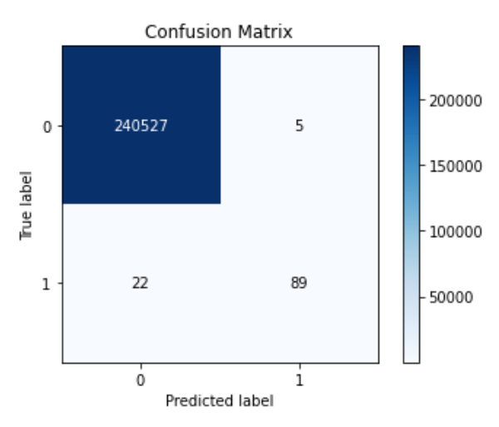
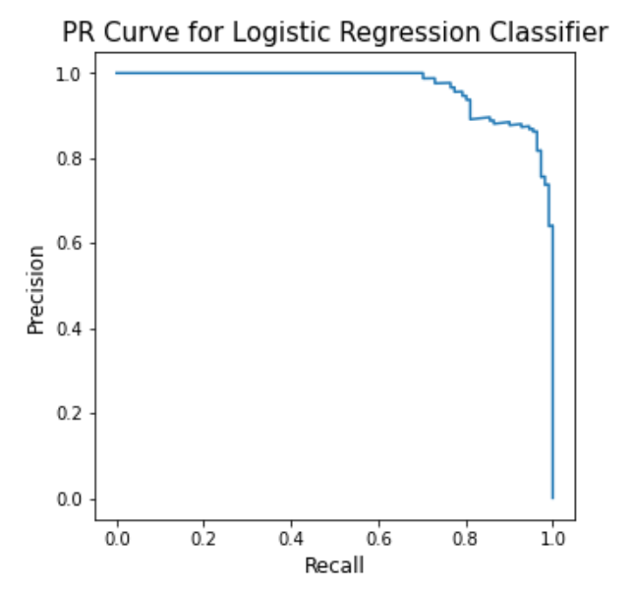
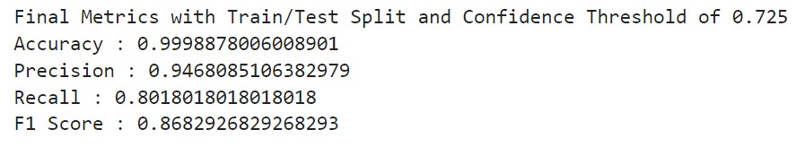
Go find some examples on the internet

